Slide 1

Brazil
By Mrs. Coxson

Slide 2
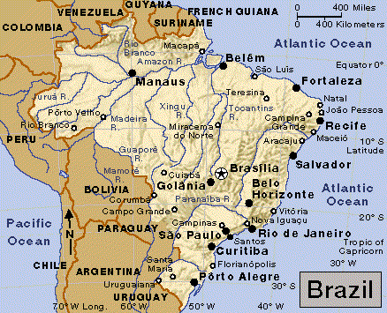
Brazil

Slide 3
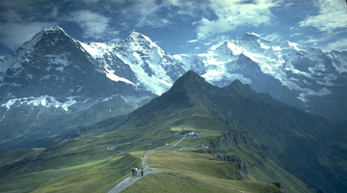
Geography

Slide 4
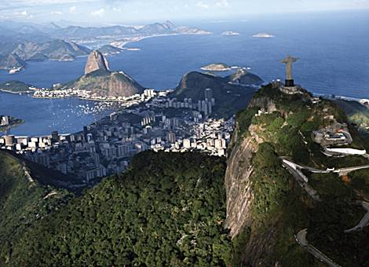
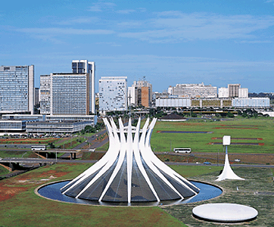
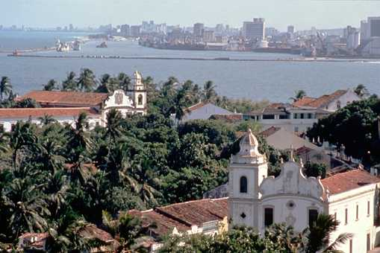
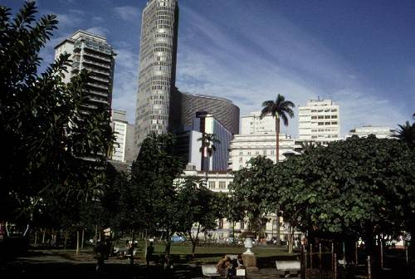
Cities
Capital – Brasilia
Other Major cities
  Belém
  Manaus
  Fortaleza
  Recife
  Rio de Janeiro
  Curitiba
  Porto Alegre
  São Paulo

Slide 5
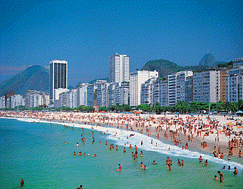
Surroundings
Atlantic Ocean
Uruguay
Argentina
Paraguay
Bolivia
Peru
Columbia
Venezuela
Guyana
Surinam
French Guiana

Slide 6
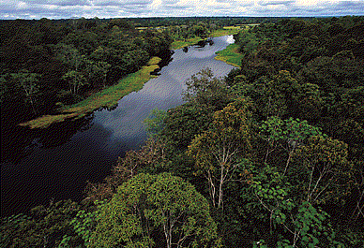
Rivers
Amazon
Xingu
Tocantins
Paranaiba
Guaporé
Madeira
Juruá
Rio Branco

Slide 7
Lakes
None

Slide 8
Mountains
Brazilian Highlands
Serra do Mar

Slide 9
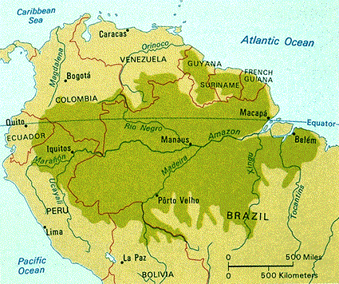
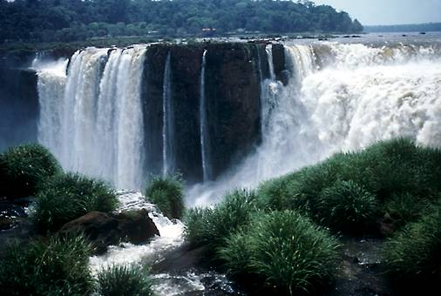
Other features
Rain Forest
Iguaçu Falls

Slide 10
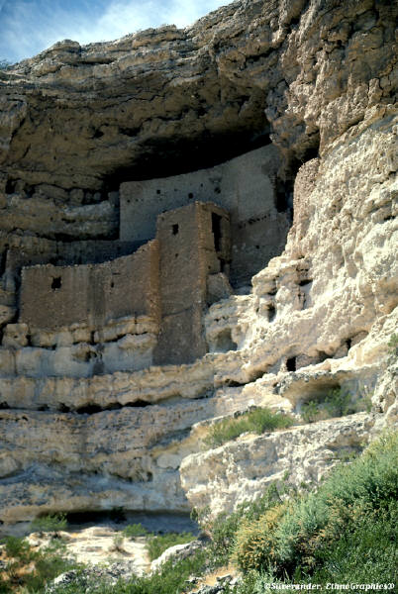
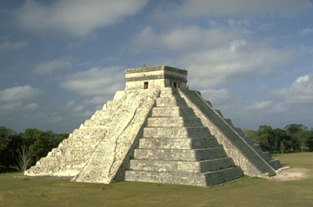
History

Slide 11
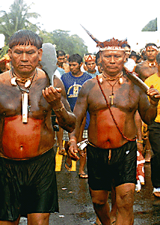
First people
Guarani and Tupinamba Indians
Lived in Brazil when Portuguese came
Gathered fruits and grew crops
Cassava was their most important crop

Slide 12
Conquerors/discoverers
Portuguese claimed Brazil for Portugal
Lead by Pedro Alvares Cabral
April 22, 1500
Peaceful takeover, enslaved Indians

Slide 13
Independence
September 7, 1822
From Portugal
1st ruler was son of Portuguese ruler

Slide 14
Important events
1500 – Portuguese landed in Brazil
1630 Dutch invaded
1808-1821 Portuguese royal family ruled from Rio de Janeiro
1822 – Independence
1888 Slavery abolished
1889 – Brazil proclaimed itself a republic
1917 – declared war on Germany
1942 –declared war on Axic
1945 – Joined UN
1946 – New constitution
1960 – Capital moved to Brazilia
1964 – military control of government
1985 – government returned to civilian control

Slide 15
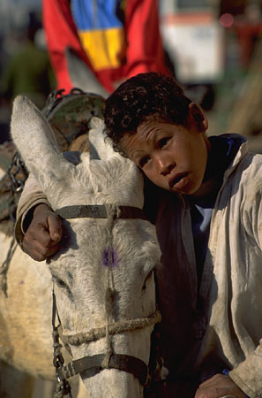
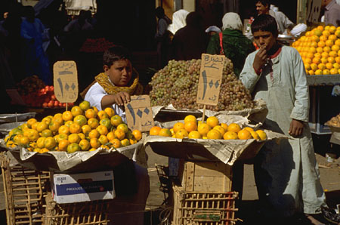
Culture

Slide 16
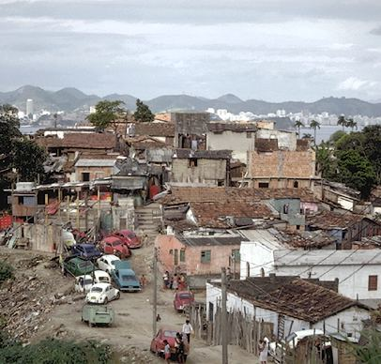
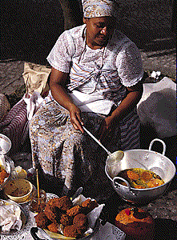
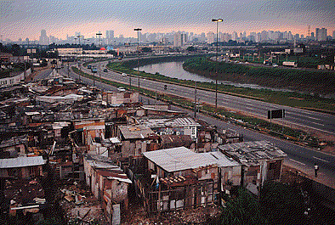
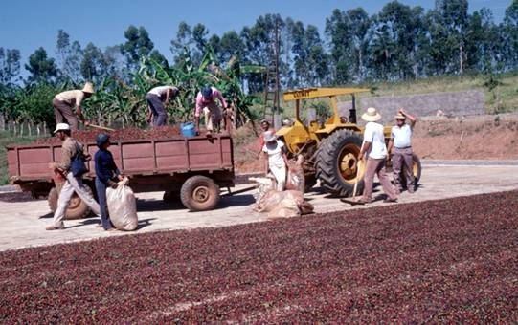
People

Slide 17
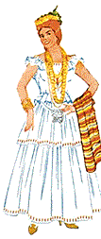
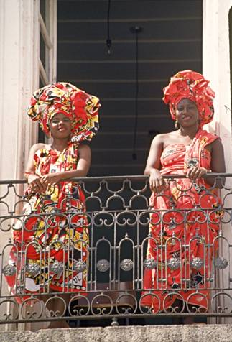
Native costume

Slide 18
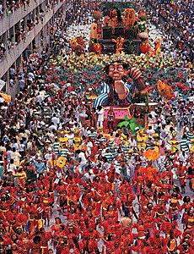
Holidays
Carnival
Catholic Holidays

Slide 19
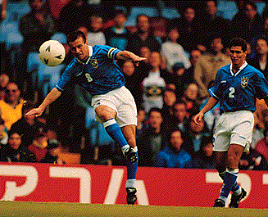
Special Customs
Soccer

Slide 20
Works cited
www.worldbookonline.com
www.encarta.msn.com

